Slide 1
Elks Marketing and Membership 2024-2025
October 18, 2024
Rick Gathen, Manager
Grand Lodge Membership & Marketing Manager

Slide 2
Tackling DELINQUENCY and Maximizing Membership GROWTH

Slide 3
Igniting the SPARK in your Lodge
Our Goal: Use special initiations to grow membership and better tools to retain members and reduce dues delinquency with better dues payment options
Why it Matters: Slow initiations and dues delinquency cost us revenue and weaken our community impact
Last year we lost $1.1 million in dues from 11,000 members left uninitiated!

Slide 4
FAST-TRACK Initiations
Why Immediate Action Matters
Delays cost, increases membership growth and engagement
Call to Action
Don’t keep candidates waiting; fast-track them into the Lodge
Successful Lodges are cutting the time a candidate waits to be initiated by holding special initiations.

Slide 5
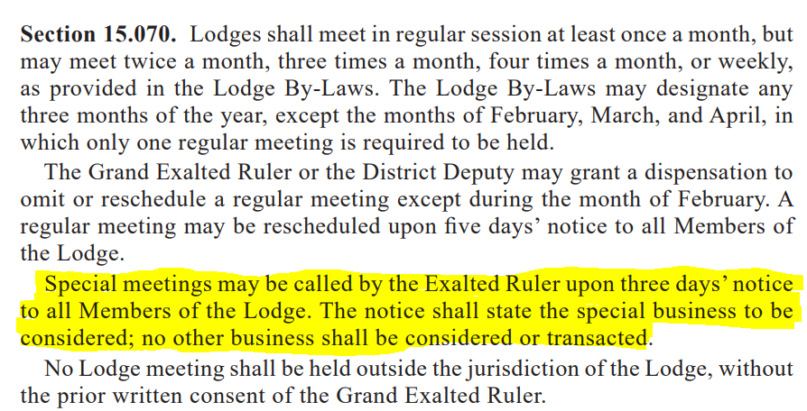
Your Lodge’s Secret WEAPON: Statute 15.070

Slide 6
3 Simple Steps to SPECIAL Initiations
Read the newly updated Investigation Manual

Slide 7
Targeted SOCIAL Media Campaigns
Targeted social media posts ENCOURAGE your members to take action!

Slide 8
Share the BENEFITS of Joining
Elks Pre-Orientation Video

Slide 9
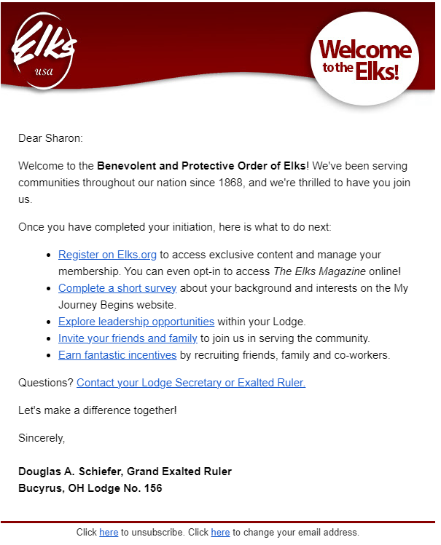
New GER
WELCOME
Greeting

Slide 10
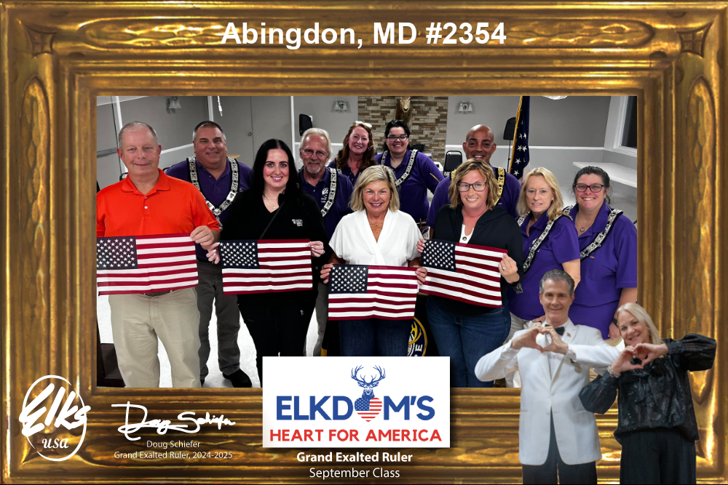
Incentives to GROW Membership
Promote Top Recruiter Incentives
Recognition and rewards for lodges and individuals
GER CHALLENGE Months (September & October):
Encourage special initiations

Slide 11
Special CHALLENGE Months
State President CHALLENGE Months (November & December):
Encourage special initiations

Slide 12
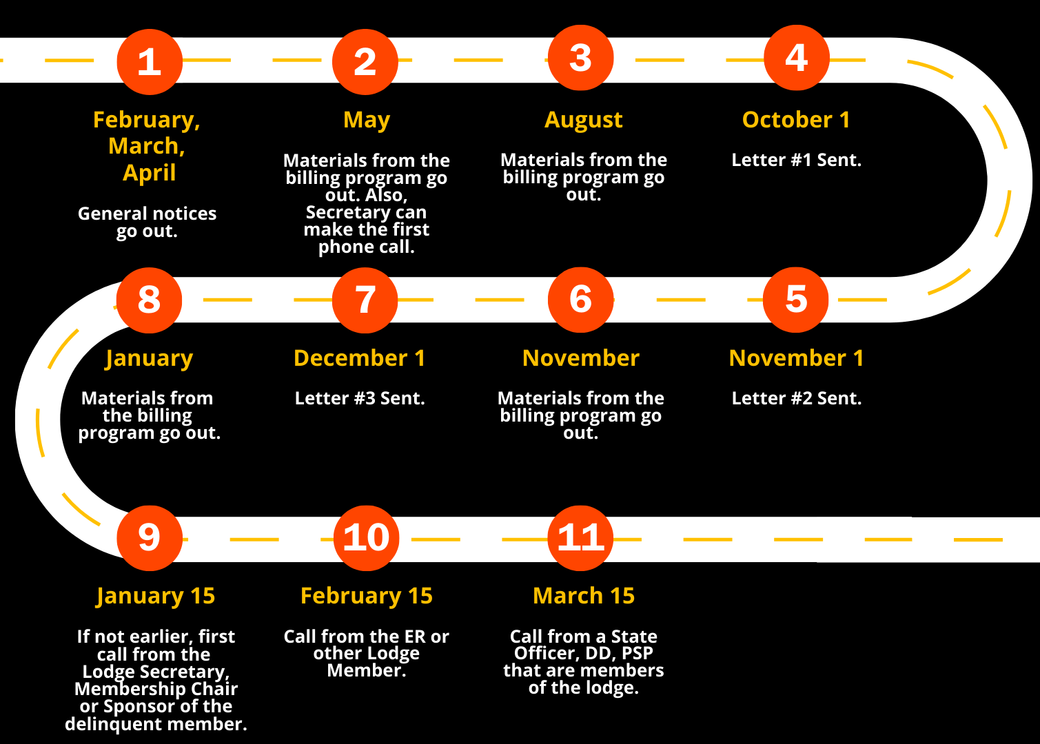
Membership RETENTION Process
Retention Timeline: Guide lodges on communication touchpoints throughout the year
Highlight key months (October, December, January) for calls and follow-ups
Tip: Keep members engaged with events and activities that make them want to stay!

Slide 13
Digital OUTREACH Strategy - EMAIL
Fast, effective, can be seen on multiple devices/platforms
Keep them brief and engaging: use a sharable to grab attention and text to provide information
Avoid sending too much content—focus on key updates
Can provide weekly updates
Do not overuse for “Stuff”
Effective Communication is CRITICAL to Reach Members!

Slide 14
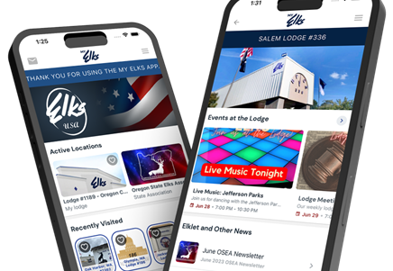
Digital OUTREACH Strategy - TEXTING
Highly effective for reminders and personal connection
Keeps the member engaged
Lodges using the free MyElks app can increase engagement – enhances retention
Effective Communication is CRITICAL to Reach Members!

Slide 15
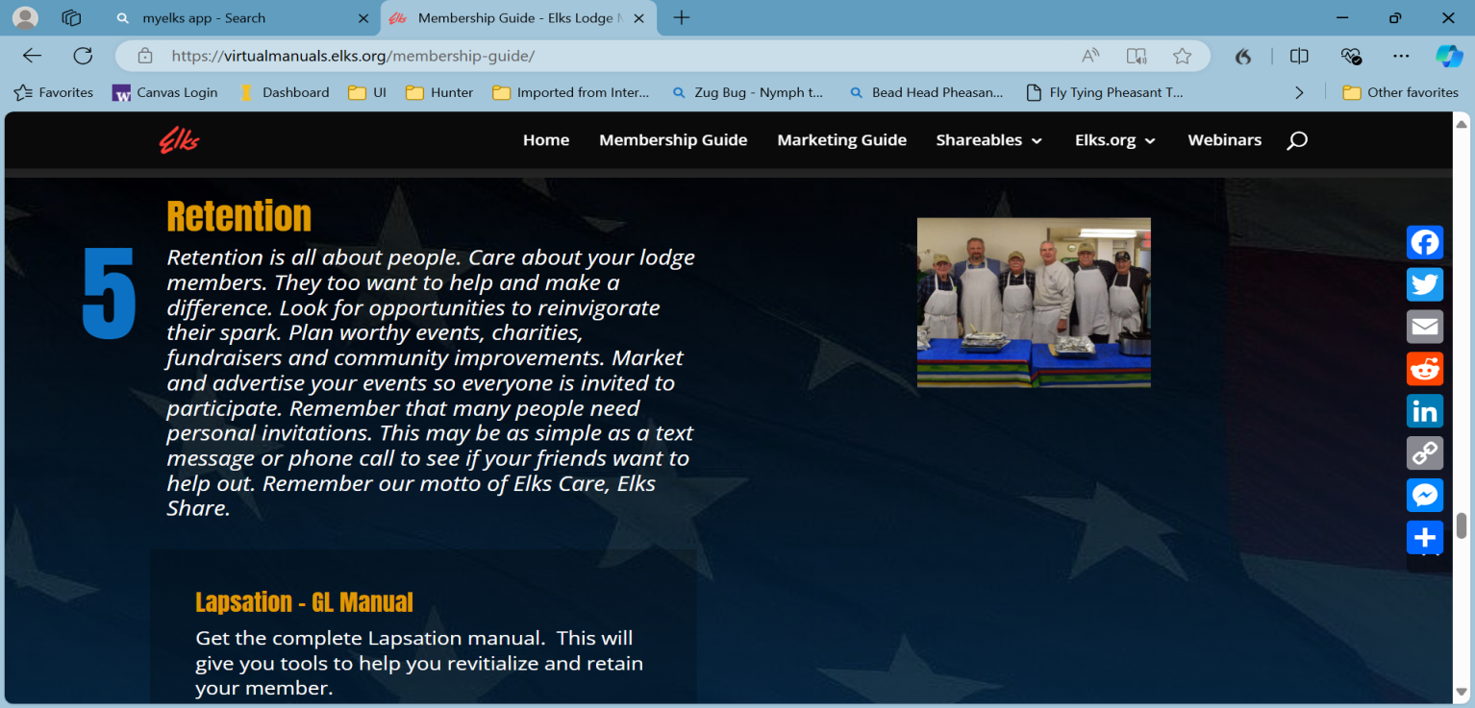
Phone Calls
Go to after other techniques have not worked
Use scripts for phone calls to call members
Multiple types depending on whom you are calling
Membership Guide - Elks Lodge Membership & Marketing Guides

Slide 16
Delinquency POST CARD Mailing
September 18th Mailing
All Lodges Benefit
Encourages Reinstatement
Provides a reminder of why dues are important

Slide 17
Tame the 3-Headed Dragon: Use ADDRESS Technology
Three-Tier Approach to Solid Address Management:
Address Element Correction (AEC)
Correct errors in address elements
Address Change Service (ACS)
Update addresses through change of service
National Change of Address (NCOA)
Track members’ new addresses nationwide
Dive Deeper: Learn About Address Management Tools
Notes:
It's important to recognize that effective membership billing plays a pivotal role in retention, directly influencing membership growth

Slide 18
National BILLING Program Overview (Summary)
Significant Lodge Savings
$0.73 to mail dues invoices via USPS vs. $0.40 per invoice
Billing Program savings is 54%, a no-brainer
Estimated savings in Lodge labor costs: 50-100 hours/year
Modern Approach
Paperless
Better reporting and tracking of payments
Easier follow-ups
No local by-law changes
Direct deposit to Lodge accounts
Payments go directly to the local Lodge
Notes:
It's important to recognize that effective membership billing plays a pivotal role in retention, directly influencing membership growth

Slide 20
Soar with 4 Video

Slide 21
Resources for SUCCESS
Useful Tools for Membership Retention
Membership Guide
https://virtualmanuals.elks.org/membership-guide/
Watch Past Training Webinars
https://virtualmanuals.elks.org/zoom-webinars/
Marketing Tools
Marketing Guide
https://virtualmanuals.elks.org/marketing-guide/
Shareables
https://virtualmanuals.elks.org/shareables/
Mobile App
https://www.my-elks.com/
Virtual manuals
https://virtualmanuals.elks.org/
Don’t forget to join the Grand Lodge Marketing & Membership Facebook Group

Slide 22
Questions?

